Slide 1


Slide 2
Brand Guideline
01
Introduction
DigiNation Marketing Department

Slide 3
Brand Guideline
DIGINATION
BRAND GUIDELINES
Overview
The main purpose of this brand Guidlines is to deliver a consistant brand.
In communication, consistency is key for having a strong brand that is clearly perceived and identifiable visual identity across all channels.
This document will help you drive a coherent brand. It will serve as your main tool to interact with internal and external partners - such as suppliers, sponsors and clients - in order to always secure the correct use of your brand.
DigiNation Marketing Department

Slide 4
Brand Guideline
IMAGINATION CAN BE DIGETAL
Slogan
The main purpose of this slogan is to
attracts attention and helps differentiate a brand
and
give a compelling message to convince potential customers to give your product or service a try
Client (imagination )= imagine a simple saving time and effort way to do his bussnies
We (digitally) =do this and make it true
.
DigiNation Marketing Department

Slide 5
Brand Guideline
02
Identity
DigiNation Marketing Department

Slide 6

Brand Guideline
Logo
Variation
DigiNation Marketing Department

Slide 7
Brand Guideline
Myriad Pro
Ag
English
Font
Regular
Semibold
Bold
ABCDEFGHIJKLMNOPQRSTUVWXYZ
abcdefghijklmnopqrstuvwxyz
0123456789
DigiNation Marketing Department

Slide 8
Brand Guideline
AlGhadTV
أج
Arabic
Font
رفيع
سميك
أ – ب – ت – ث – ج – ح – خ – د – ذ – ر – ز – س – ش – ص – ض – ط – ظ – ع – غ – ف – ق – ك – ل – م – ن – هـ – و – ي
٠ ١ ٢ ٣ ٤ ٥ ٦ ٧ ٨ ٩
DigiNation Marketing Department

Slide 9
Brand Guideline
Green
Blue
#1C8A55
Colors
Solid
#2196C7
Turquoise
Light Blue
#54C5D2
#7CB8E4
Black
#141414
DigiNation Marketing Department

Slide 10
Brand Guideline
Green
Blue
Blue
Turquoise
Colors
Gradient
#1C8A55
#2196C7
Green
Turquoise
#1C8A55
#2196C7
#1C8A55
#54C5D2
DigiNation Marketing Department

Slide 11
Brand Guideline
03
Stationary
DigiNation Marketing Department

Slide 12


Brand Guideline
Size :
5x9
Material :
Paper
Business Card
DigiNation Marketing Department

Slide 13
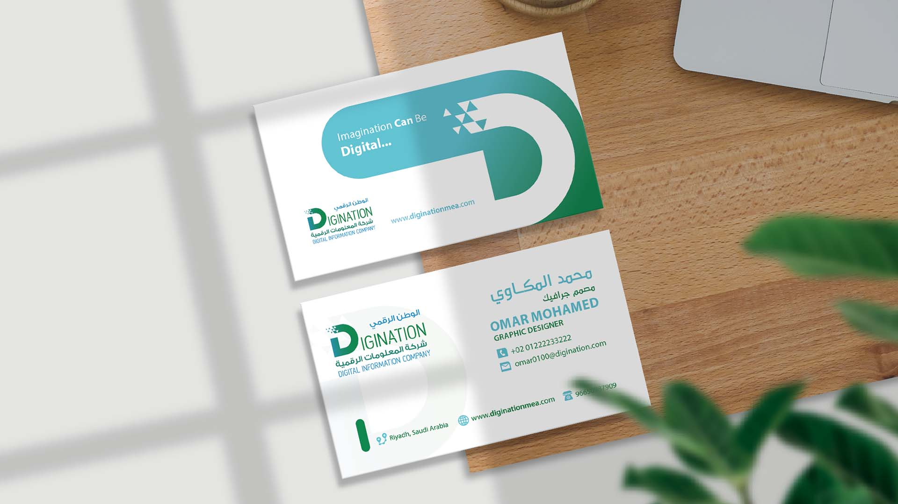
Brand Guideline
DigiNation Marketing Department

Slide 14

Brand Guideline
Size :
A4
Material :
Paper
Letterhead
DigiNation Marketing Department

Slide 15

Brand Guideline
DigiNation Marketing Department

Slide 16


Brand Guideline
Folder
DigiNation Marketing Department

Slide 17
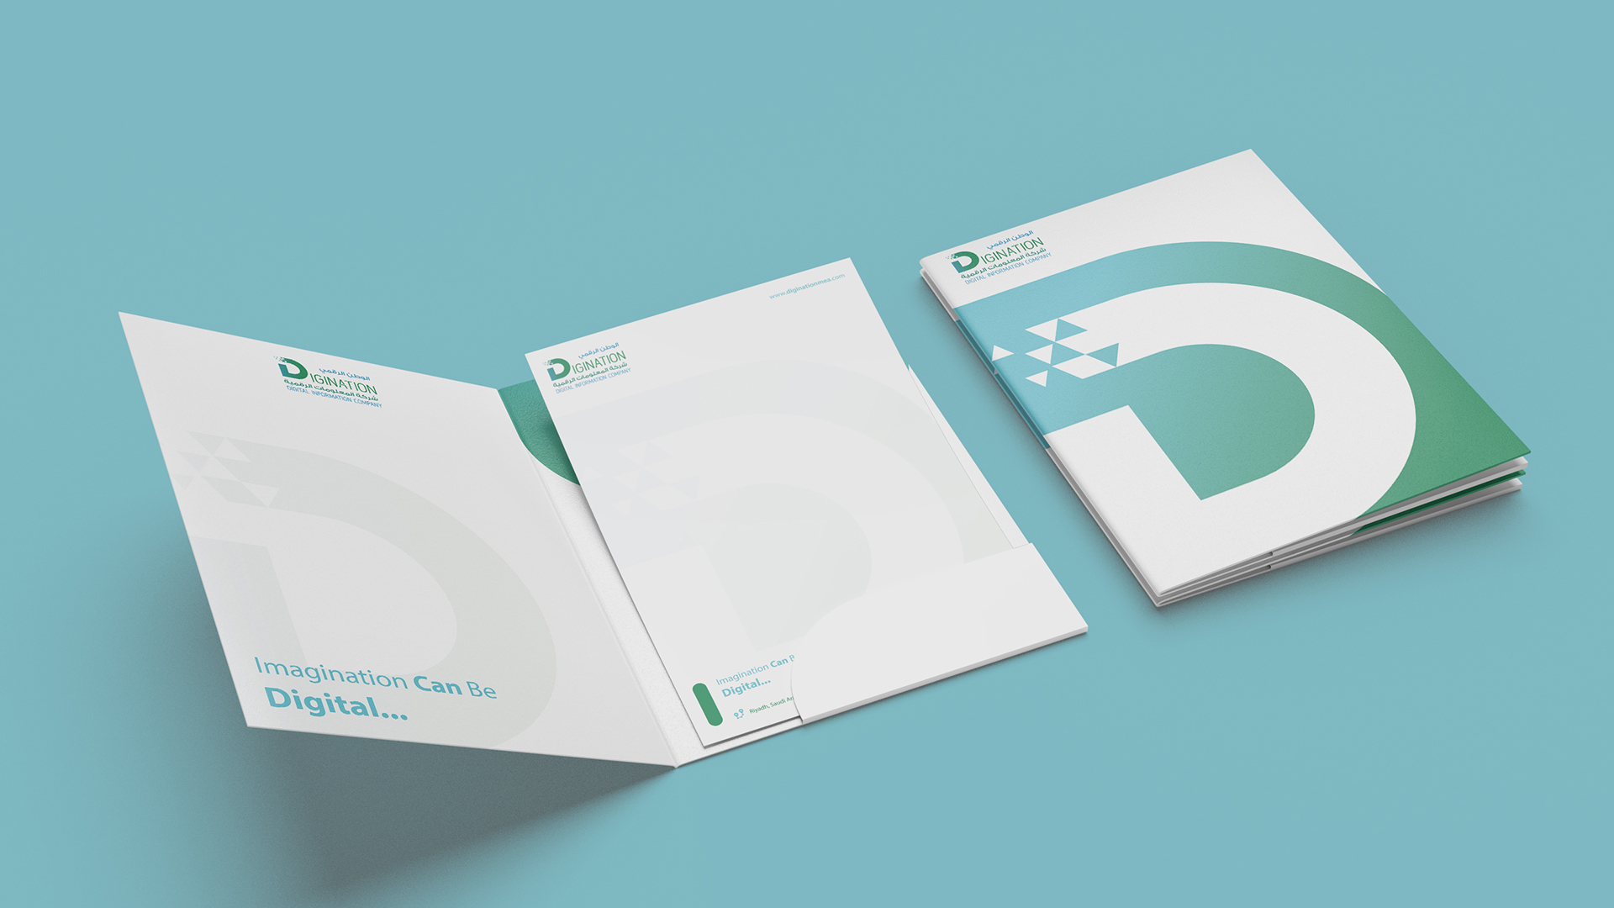
Brand Guideline
DigiNation Marketing Department

Slide 18
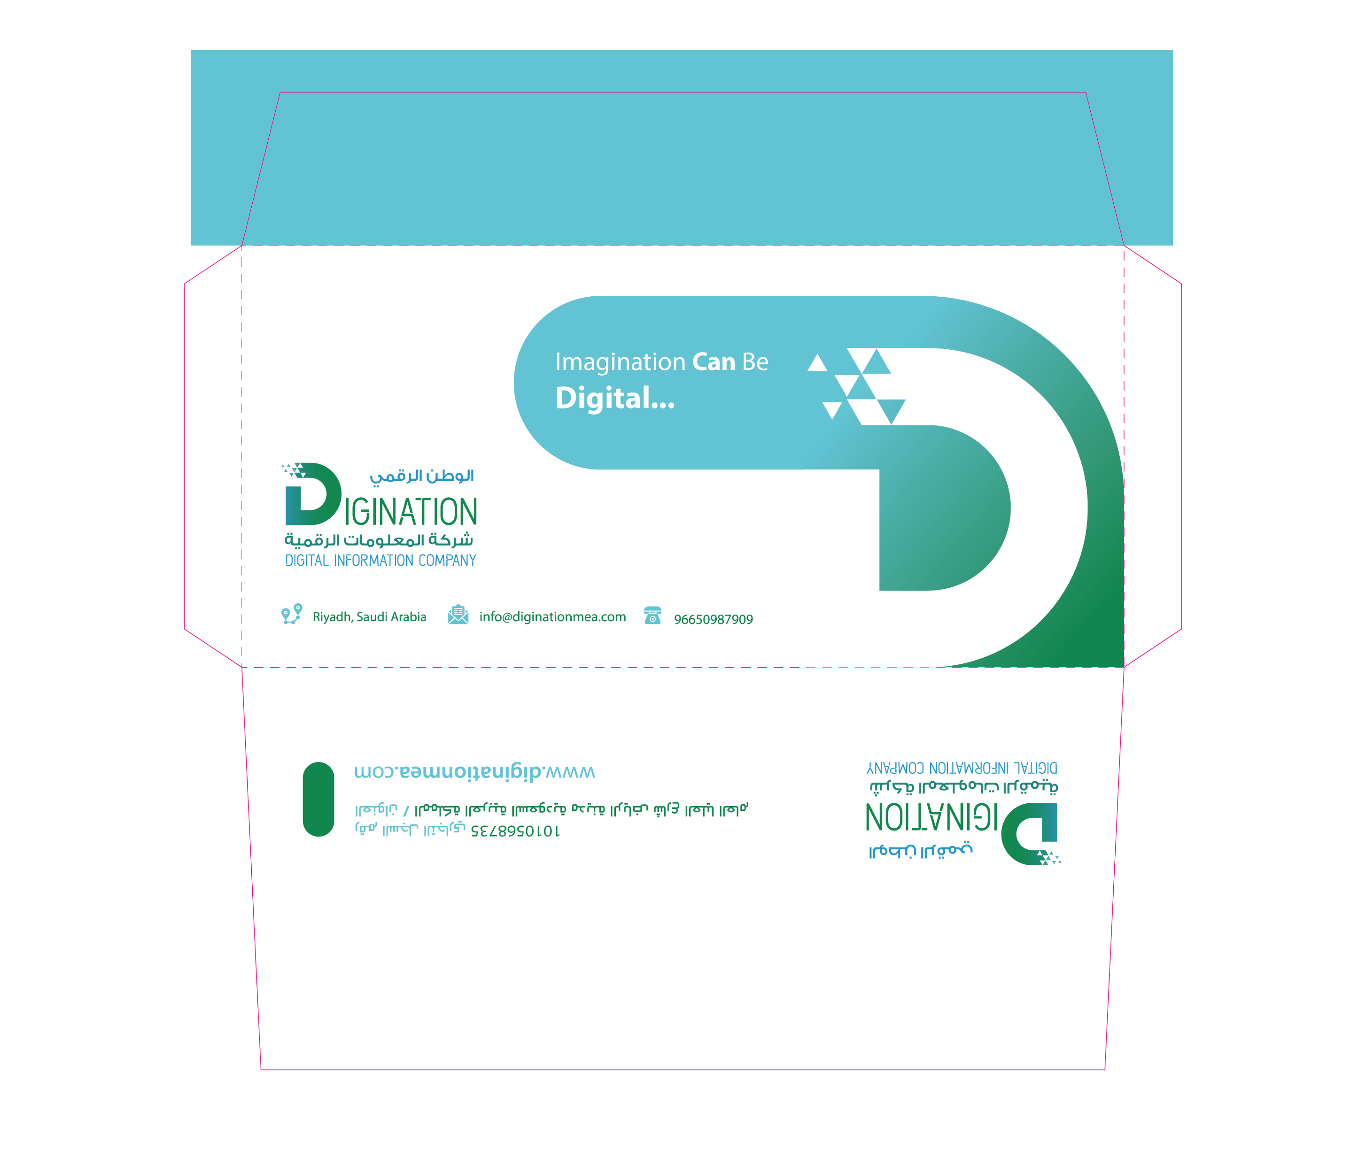
Brand Guideline
American
Envelop
DigiNation Marketing Department

Slide 19
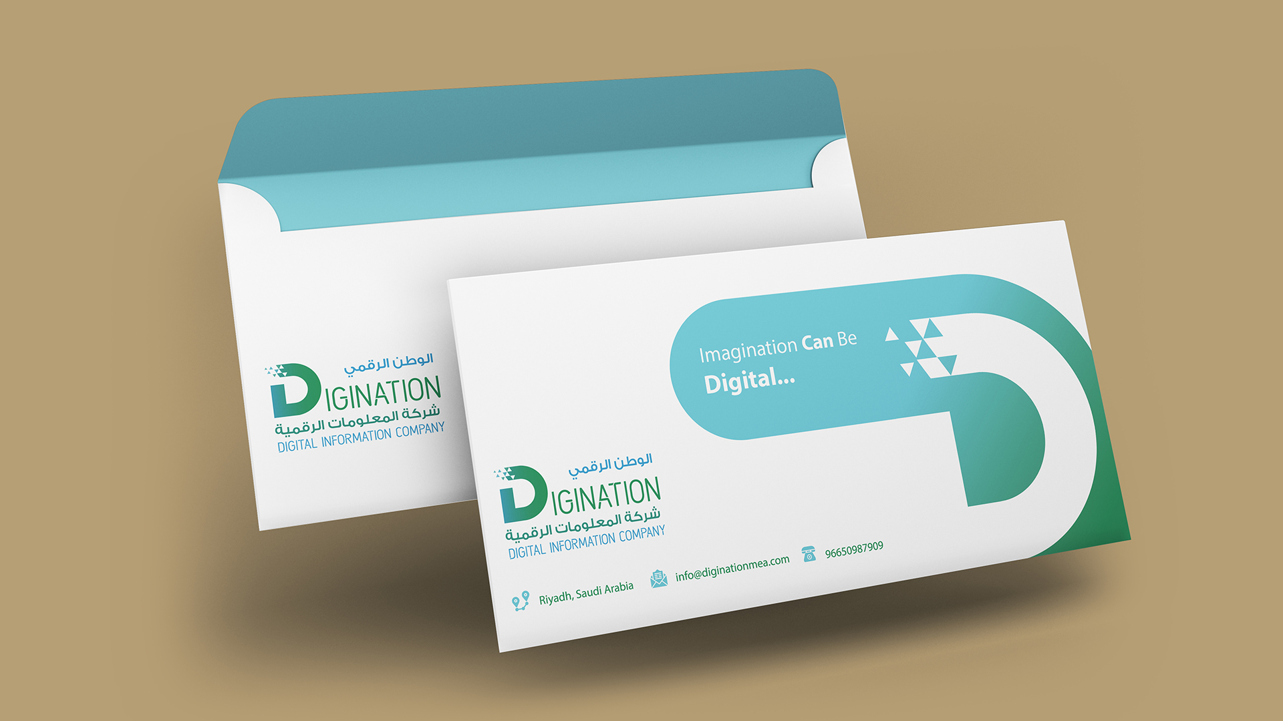
Brand Guideline
DigiNation Marketing Department

Slide 20



Brand Guideline
Wallpaper
Microsoft
Teams
&
Zoom
PC
DigiNation Marketing Department

Slide 21
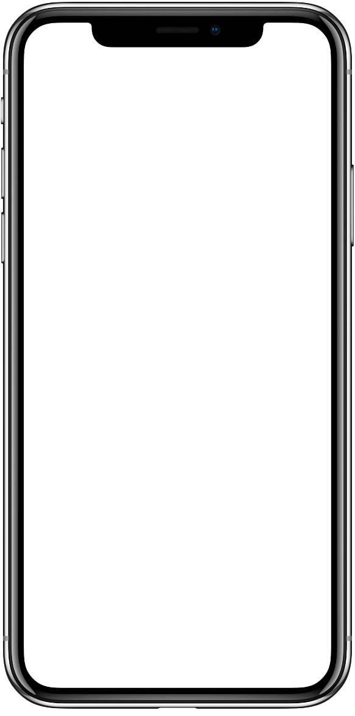
Brand Guideline
Wallpaper
Zoom
Mobile
DigiNation Marketing Department

Slide 22
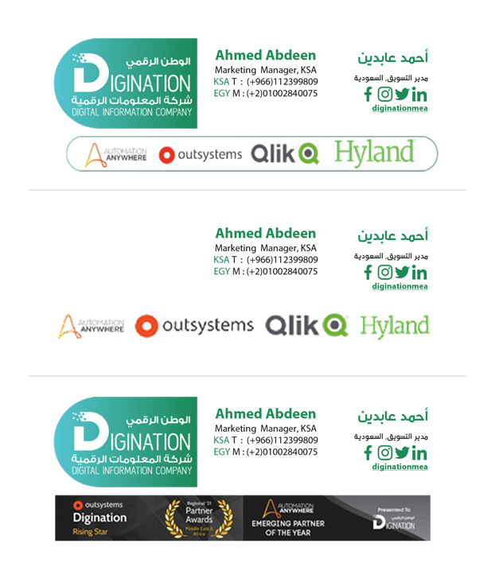
Brand Guideline
EMAIL Signature
Jpg
DigiNation Marketing Department

Slide 23
Brand Guideline
Thank You
Ahmed Abdeen
Marketing Manager
aabdeen@diginationmea.com
00201002840075
© Copyright DigiNation 2022. All rights reserved. All material on this presentation, including, but not limited to, design, text, images and logos are owned by DigiNation, either through copyright or trademark, unless otherwise indicated. All rights are reserved by DigiNation . Content may NOT be copied, reproduced, transmitted, distributed, downloaded or transferred in any form or by any means without DigiNation’ prior written consent, and with express attribution to DigiNation . Copyright infringement is a violation subject to criminal and civil penalties.
(For permission to reprint, please contact DigiNation at +00966509879090 or via email at info@diginationmea.com )
DigiNation Marketing Department

